Slide 1
Primary Technical Documentation
Joshua Bartle

Slide 2
Natural Language Processing: Text Error Detection and Auto-completion
Building Blocks
Finite State Machines to Define a language and detect Errors
“Finite-state automata (both acceptors and transducers) play increasingly important role in natural language processing. There main advantages are their small size as compared with the data they hold . . . and the very fast lookup of string in an automaton -- proportional to the length of the string. . . In natural language processing, they are used for tasks like spelling correction . . .” (Dakiuk, Jan)
“For error-tolerant recognition, one needs to find all paths from the start node to one of the final nodes, so that when the labels on the links along a path are concatenated, the resulting string is within a given edit distance threshold t, . . . “(Oflazer, Kemal 75)
Summary of quotes/Algorithms
The best way to define a language is to implement it in terms of states, this reduces size and increases speed of processing strings in a language
Finite State machines can also be used to measure the edit distance between incorrectly spelled words to a correctly spelled word in our dictionary. This can be done by measuring how many operations (insertions, deletions, transpositions) are required to reach an accepting state.

Slide 3
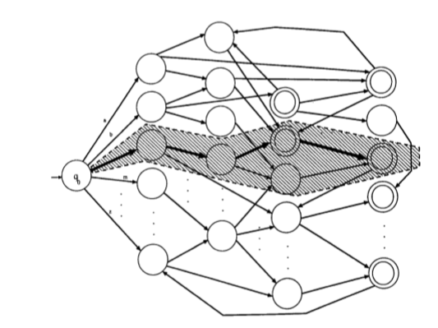
State Machine Diagram
Visual representation of a Finite State Machine
When a dead state is reached (a state that has no way to reach an accepted state), the path that requires the least amount of changed to reach an accepted state is chosen.
(Oflazer, Kemal 75)

Slide 4
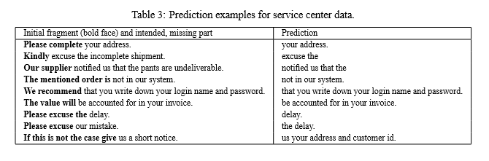
Multi-Word Models for Error Detection and Auto-Completion
“First, we use it to find pairs of words that function together as a single lexical entity. Then, by examining the probability that two words will appear within a reasonable distance of one another, we use it to find classes that have some loose semantic coherence.” (Brown, Peter F., et al 467)
NOTE: Using N-Gram models for auto-correct and auto-complete work similarly, we can use probabilities of word combinations in training text to determine spelling correction actions or auto-complete actions.
(Bickel, Steffen et al. 198)

Slide 5
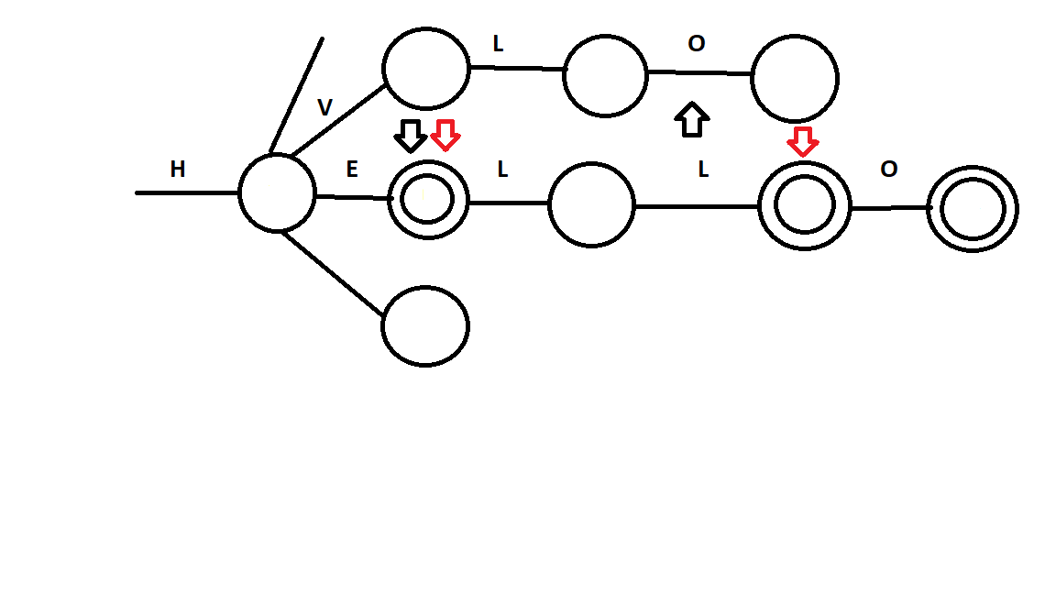
Using State Machines AND N-Gram Algorithms Together: How I intend to combine them
Given this example created in MS PAINT you can see where using a multi-word analysis with FSM would be useful
Given user input: HVLO, we can generate HELLO with one insertion of L and one transposition of V to E. We can also generate HELL by transposing V and E and O to L. Both of these changes require to operations, which makes it difficult to choose which word the user intended to input
By analyzing various texts from user history or other documents, one can train our N-Gram modeled algorithm on data to calculated the probability that the user would use HELL vs HELLO.

Slide 6
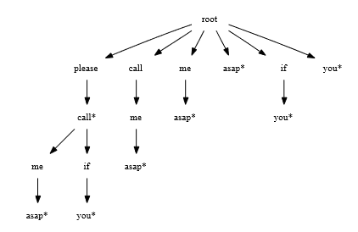
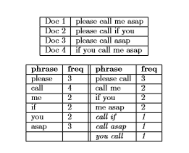
Creating search trees for phrases
“Suﬃx trees are widely used, and are ideal data structures to determine completions of given strings of characters. Since our concern is to ﬁnd multi-word phrases, we propose to deﬁne a suﬃx tree data structure over an alphabet of words.” (Nandi, Arnab, and H. V. Jagadish. 222)
“The construction of suﬃx trees typically uses a sliding window approach.” (Nandi, Arnab, and H. V. Jagadish. 223)
Summary of Diagrams
Creating a suffix tree for phrases allows one to efficiently store common phrases and word combinations in the form of a search tree.
This can be created by taking a phrase or words and expanding all other combinations of phrases as nodes in a search tree.
Frequencies of words and combinations of words can be stored with their probabilities.
The * after each word denotes the end of a phrase or word group. This can be used to determine which phrases have probabilities associated with them.
(Nandi, Arnab, and H. V. Jagadish. 222)
(Nandi, Arnab, and H. V. Jagadish. 224)

Slide 7
Other Enhancements
Identifying Casing Errors
“For example, consider the phrase with improper casing, “shipping TIME frame”. Appearing as an independent word, “TIME” has an equally likely chance of being a word (with improper casing) or an acronym for “Timed Interactive Multimedia Extensions”” (Wong, Wilson et al. 85)
“When the neighboring words “shipping” and “frame” are taken into considerations, then the probability of “TIME” being an acronym becomes signiﬁcantly less.” (Wong, Wilson et al. 85)
The previous quotes discuss detection casing errors. This can be something very useful in error detection. This also using N-gram or multiword probabilities to assess if a word such as “TIME” has incorrect casing or may be an acronym

Slide 8
Final Objective
Statement: To compare the effectiveness of n-gram techniques versus single-word analysis by using the methods described in “Predicting Sentences Using N-Gram Language Models.” by Bickel, Steffen et al., for text error correction.(1.5 person-weeks over 1 semester)
Notes:
Now have a set objective or goal. Now that this has been set, deciding how to build this research project will be the next step

Slide 9
Steps that can be taken (just some thoughts)
Create Finite State Machine (FSM) to define a language (the English dictionary in this case).
Using a set of testing text (with errors), use FSM to compute edit distance(how many changes are needed to correct a word) described in “Error-Tolerant Finite-State Recognition and Applications to Morphological Analysis and Spelling Correction.” by Oflazer, Kemal.
Take measurements of accuracy. How many words were correctly corrected to what was intended?

Slide 10
Steps to be taken cont...
Applying n-gram models
Using training text, create parse trees of all word sequences, using a sliding window method described in “Effective Phrase Prediction” by Nandi, Arnab and H.V. Jagadish. (This is how word sequences and their number of occurrences will be stored)
Compute the probability that a sequence of 1 to n words appear together (These will be the tests, there will be a test for 1 word, 2, word, … , n word probabilities). The probabilities calculated by the occurences of phrases of n length will be used to determine what incorrectly spelled words are corrected to.

Slide 11
What will be measured
Accuracy of using edit distance (single-word analysis)
Accuracy of using n-gram probabilities from training text
Get Accuracy when considering 1, 2, … , n words in a sequence (Words will be corrected based on the probability of word sequences)

Slide 12
Some Changes Since Last Update
Updated Objective (Now using n-gram models as an enhancement with edit distance rather than a separate thing)
Added Experiment Design w/ Block Design
Still Working on finishing up the goal tree. Will be added in in next update

Slide 13
Objective Statement Updated
To compare the effectiveness of n-gram techniques versus single-word analysis by using the methods described in “Predicting Sentences Using N-Gram Language Models.” by Bickel, Steffen et al., for text error correction.(1.5 person-weeks over 1 semester)
- Note: Rather than looking at n-gram techniques compared to edit distance separately, I am measuring edit distance by itself and edit distance with n-gram techniques to enhance accuracy by breaking ties when the edit distance of two words are equal, or a correct word cannot be determined

Slide 14
Experiment Design
Description: A finite state machine is created from a dictionary containing all words in the English language. The finite state machine is then used along with 10 random test documents from a set of 15 documents to correct random errors in the document using edit distance to decide corrections. This accuracy method is then compared with the addition of the n-gram model with different values of n.
Each n-gram run will also use 10 random documents for testing correction, but will also use the other 5 of those documents for training. Training involves calculating frequencies and probabilities that a sequence of n words will appear in text. These sequence probabilities will then be used in the 10 test documents to determine corrections for incorrectly spelled words.
The n-gram model will be tested with values of 1-4 for n and there will be a total of 10 trials comparing edit distance by itself versus n-gram techniques as an enhancement with edit distance.

Slide 15
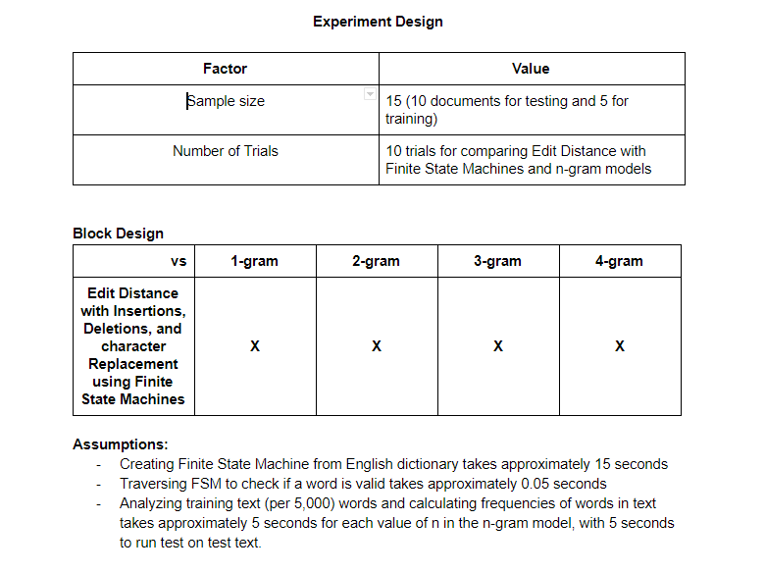
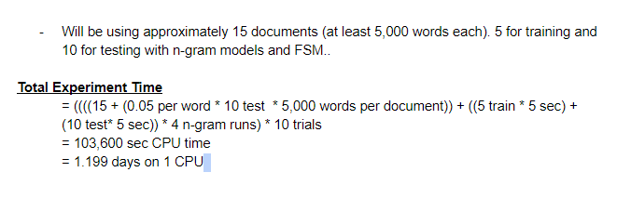
Block Design

Slide 16
Ongoing Progress
Currently drawing out visual representations of how my algorithms work so they can be better explained along with some pseudocode. While I understand how these things work, I find it difficult explaining them, so visuals should make that easier for proposal presentation and explanations of the algorithms.
Finishing up a goal tree

Slide 17
Bibliography
Bickel, Steffen et al. “Predicting Sentences Using N-Gram Language Models.” Proceedings of the conference on Human Language Technology and Empirical Methods in Natural Language Processing - HLT ’05 October (2005): 193–200. Web.
Brown, Peter F., et al. “Class-Based N-Gram Models of Natural Language" Computational Linguistics 1950 (1992): Print.
Daciuk, Jan. “Finite State Tools for Natural Language Processing.” Proceedings of the COLING-2000 Workshop on Using Toolsets and Architectures To Build NLP Systems (2000). Print.
Nandi, Arnab, and H. V. Jagadish. “Effective Phrase Prediction.” Proceedings of the 33rd International Conference on Very Large Data Bases (2007): 219-230. Web.
Oflazer, Kemal. “Error-Tolerant Finite-State Recognition with Applications to Morphological Analysis and Spelling Correction.” Computational Linguistics 22.1 (1996): 73–89. Web.
Wong, Wilson et al. “Integrated Scoring for Spelling Error Correction, Abbreviation Expansion and Case Restoration in Dirty Text.” Conferences in Research and Practice in Information Technology Series 61 (2006): 83–89. Print.

